Slide 1


Arthur Paruzel
10/28/2022

Slide 2

Outline
Executive Summary
Introduction
Methodology
Results
Conclusion
Appendix

Slide 3
Executive Summary
Summary of methodologies
Data Collection and Aggregation using API
Data Collection and Aggregation using web scraping
Data Wrangling
Exploratory Data Analysis using SQL and IBM DB2
Exploratory Data Analysis with Python and Matplotlib/Seaborn
Interactive Visual Analytics with Folium
Interactive Visual Analytics with Python and Plotly
Machine Learning Modelling and Prediction
Supervised machine learning algorithms: K-Nearest Neighbors, Tree, Supported Vector Machine, Logistic Regression
Model Optimization using Grid Search and scoring: F1
Summary of all results
Exploratory Data Analysis Results
Interactive Visual Analysis Results
Predictive Analysis Results

Slide 4
Introduction
Project background and context
Space X advertises Falcon 9 rocket launches on its website with a cost of 62 million dollars; other providers cost upward of 165 million dollars each, much of the savings is because Space X can reuse the first stage. Therefore, if we can determine if the first stage will land, we can determine the cost of a launch. This information can be used if an alternate company wants to bid against space X for a rocket launch. This goal of the project is to create a machine learning pipeline to predict if the first stage will land successfully.
Problems you want to find answers
- What factors determine if the rocket will land successfully? - The interaction amongst various features that determine the success rate of a successful landing. - What operating conditions needs to be in place to ensure a successful landing program.

Slide 5

Section 1

Slide 6
Methodology
Executive Summary
Data collection methodology:
Data was collected using SpaceX API and web scraping from Wikipedia
Data wrangling
One-hot encoding was applied to categorical features to standardize data for predictive modeling.
Exploratory Data Analysis (EDA) using visualization and SQL
Interactive visual analytics using Folium and Plotly Dash
Predictive analysis using classification models
4 classifiers were compared to determine best fitted for the Predictive Analysis.
All 4 classifiers were built, trained and then tested on the available datasets
For each model type multiple parameters were evaluated to fine tune the model to the best results.
Goal was to to determine the model with highest prediction accuracy.

Slide 7
Data Collection
The data was collected using various methods
Data collection was done using get request to the SpaceX API.
Next, we decoded the response content as a Json using .json() function call and turn it into a pandas dataframe using .json_normalize().
We then cleaned the data, checked for missing values and fill in missing values where necessary.
In addition, we performed web scraping from Wikipedia for Falcon 9 launch records with BeautifulSoup.
The objective was to extract the launch records as HTML table, parse the table and convert it to a pandas dataframe for future analysis.

Slide 8
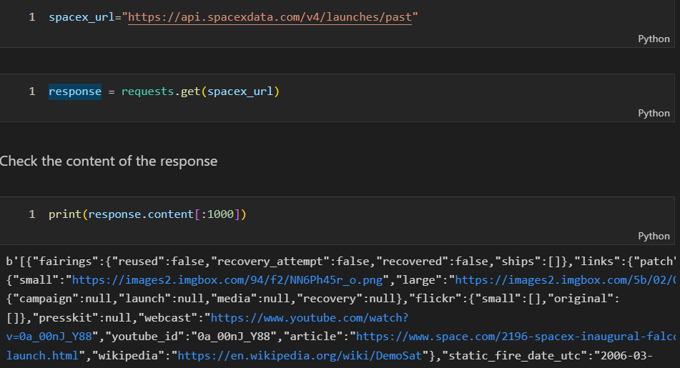
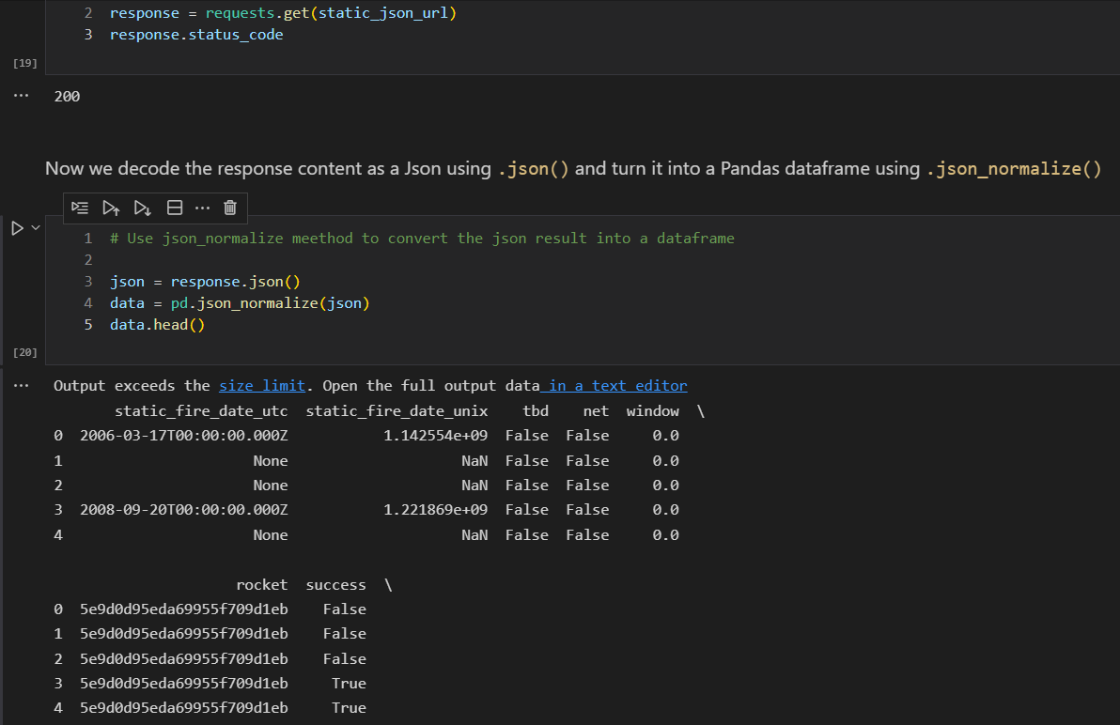
Data Collection – SpaceX API
SpaceX API was used to collect data.
Data was cleaned, normalized, and some basic wrangling was performed.
The link to the jupyter notebook with API https://github.com/ArthurParuzel/SpaceXDataScience/blob/main/1.%20Data%20Collection%20API%20Web%20Scraping/jupyter-labs-spacex-data-collection-api.ipynb

Slide 9
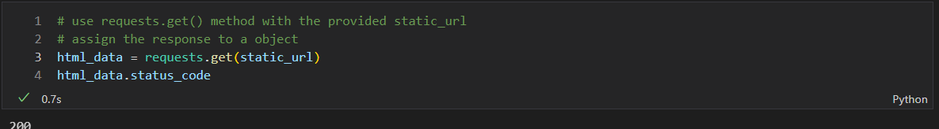
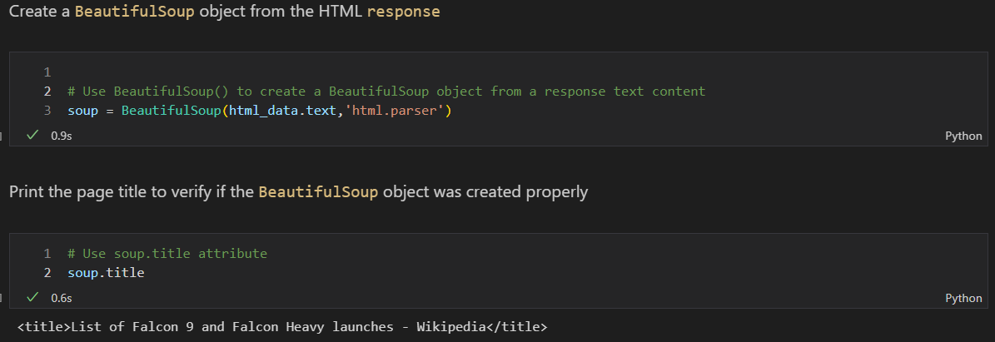
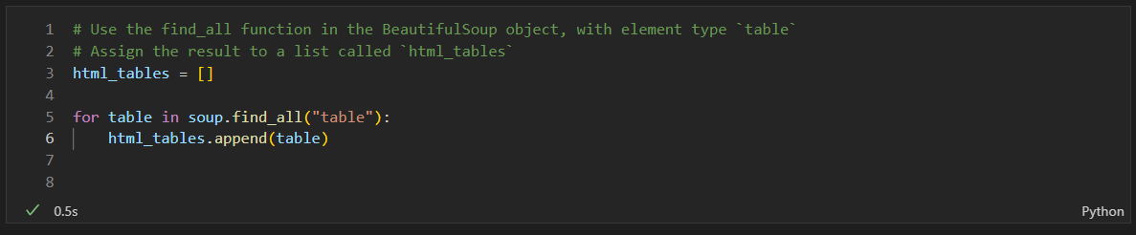
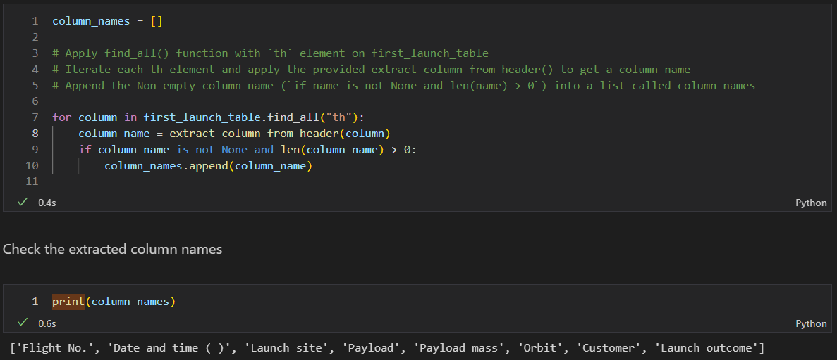
Data Collection - Scraping
Data was web scrapped from Wikipedia website using BeautifulSoup library.
HTML table was parsed and converted into data frame for further analysis.
The link to the Jupiter notebook with Web Scraping https://github.com/ArthurParuzel/SpaceXDataScience/blob/main/1.%20Data%20Collection%20API%20Web%20Scraping/jupyter-labs-webscraping.ipynb

Slide 10

Data Wrangling
Data was loaded into Pandas DataFrame
We performed exploratory data analysis and determined the training labels.
We identified the percentage of missing values for each attribute
We identified which columns are numerical and categorical
We calculated number of launches for each site
We calculated the occurrences of each mission for each orbit
We calculated distribution of mission outcome for each orbit
We created landing outcome (“1”=success/”0”=failure) classification variable for each mission.
Link to Jupiter notebook with data wrangling https://github.com/ArthurParuzel/SpaceXDataScience/blob/main/1.%20Data%20Collection%20API%20Web%20Scraping/labs-jupyter-spacex-Data%20wrangling.ipynb

Slide 11
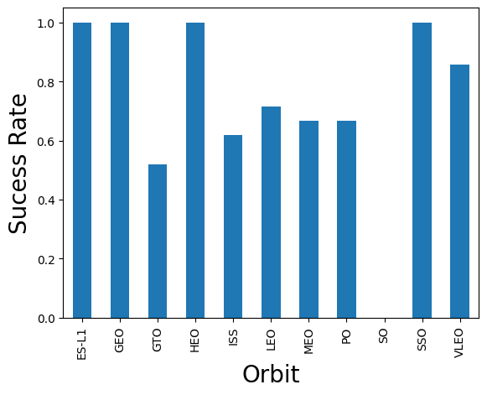
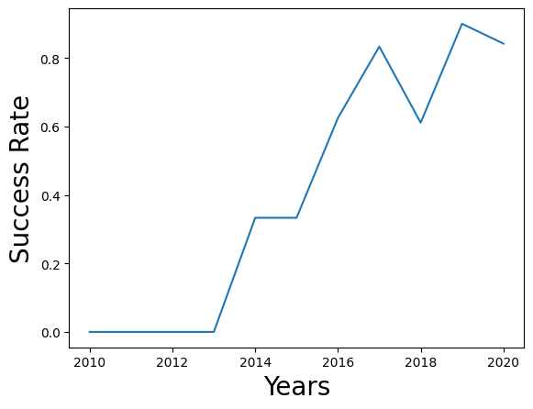
EDA with Data Visualization
We explored the data by visualizing the relationship between flight number and launch Site, payload and launch site, success rate of each orbit type, flight number and orbit type, the launch success yearly trend.
Link to jupyter notebook with EDA with Data Visuzalization
https://github.com/ArthurParuzel/SpaceXDataScience/blob/main/2.%20Exploratory%20Data%20Analysis%20with%20(SQL%2C%20Matplotlib)/jupyter-labs-eda-dataviz.ipynb

Slide 12
EDA with SQL
SpaceX Dataset was loaded into IBM DB2 database and analyzed using jupyter notebook.
EDA with SQL allowed to get insights from the data. SQL queries helped us answer following questions
The names of the unique launch sites in the space mission
The total payload mass carried by boosters launched by NASA (CRS)
Average payload mass carried by booster version F9 v1.1
The names of the boosters which have success in drone ship for specific payload range (4k-6k)
The total number of successful and failure mission outcomes
The names of the booster_versions which have carried the maximum payload mass
the failed landing_outcomes in drone ship, their booster versions, and launch site names for specific year
Rank and the count of all possible landing outcomes (such as Failure (drone ship) or Success (ground pad))
Link to Jupiter notebook with full SQL EDA https://github.com/ArthurParuzel/SpaceXDataScience/blob/main/2.%20Exploratory%20Data%20Analysis%20with%20(SQL%2C%20Matplotlib)/jupyter-labs-eda-sql-coursera.ipynb

Slide 13
Build an Interactive Map with Folium
All launch sites have been marked, and map objects such as markers, circles, lines to mark the success or failure of launches for each site have been added onto the folium map.
We assigned the feature launch outcomes (failure or success) to class 0 and 1.i.e., 0 for failure, and 1 for success.
Using the color-labeled marker clusters, we identified which launch sites have relatively high success rate.
We calculated the distances between a launch site to its proximities. We answered some question for instance:
Are launch sites in close proximity to railways?
Are launch sites in close proximity to highways?
Are launch sites in close proximity to coastline?
Do launch sites keep certain distance away from cities?
Link to Jupiter notebook
https://github.com/ArthurParuzel/SpaceXDataScience/blob/main/3.%20Dashboards%20with%20Plotly/lab_jupyter_launch_site_location.ipynb

Slide 14
Build a Dashboard with Plotly Dash
We built an interactive dashboard with Plotly dash. It allowed us to observe correlation between certain dataset elements dynamically.
We plotted pie charts showing the total launches by a certain sites. It can allow simple analysis and comparison between different sites.
We plotted scatter graph showing the relationship with Outcome and Payload Mass (Kg) for the different booster version. This allowed us to compare flight results broken down to light, medium and heavy payloads against different booster versions.
Link to Python Plotly server code running the dashboard can be found here
https://github.com/ArthurParuzel/SpaceXDataScience/blob/main/3.%20Dashboards%20with%20Plotly/spacex_dash_app.py

Slide 15
Predictive Analysis (Classification)
We loaded the data using numpy and pandas, transformed the data, split our data into training and testing.
We built different machine learning models and tune different hyperparameters using GridSearchCV.
We used accuracy as the metric for our model, improved the model using feature engineering and algorithm tuning.
We found the best performing classification model.
Link to Jupiter notebook can be found here
https://github.com/ArthurParuzel/SpaceXDataScience/blob/main/5.%20Final%20Report%20and%20findings/SpaceX_Machine%20Learning%20Prediction_Part_5%20CLOUD.ipynb

Slide 16
Results
Exploratory data analysis results
Interactive analytics demo in screenshots
Predictive analysis results

Slide 17

Section 2

Slide 18
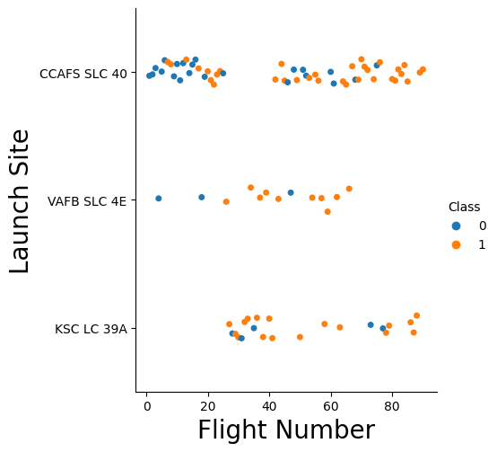
Flight Number vs. Launch Site
From the plot, we found that the larger the flight amount at a launch site, the greater the success rate at a launch site.

Slide 19
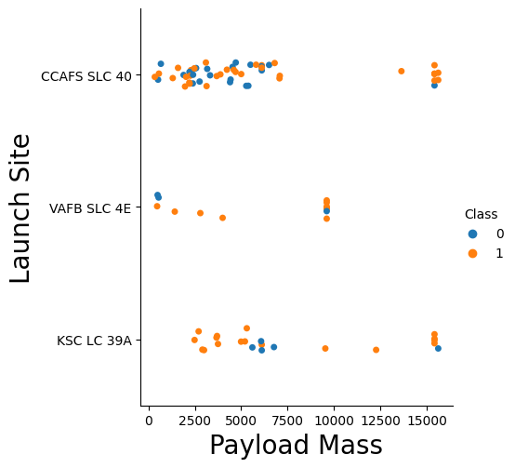
Payload vs. Launch Site
From the plot, we found that the greater the payload mass for the launch sites KSC LC 39A and CCAFS SLC 40 the higher the success rate for the rocket.
KSC LC 39A site has majority of the failures for the mid range of payload, between 5000 and 7500

Slide 20
Success Rate vs. Orbit Type
From the plot, we can see that ES-L1, EO, HEO, SSO,VLEO had the most success rate.

Slide 21
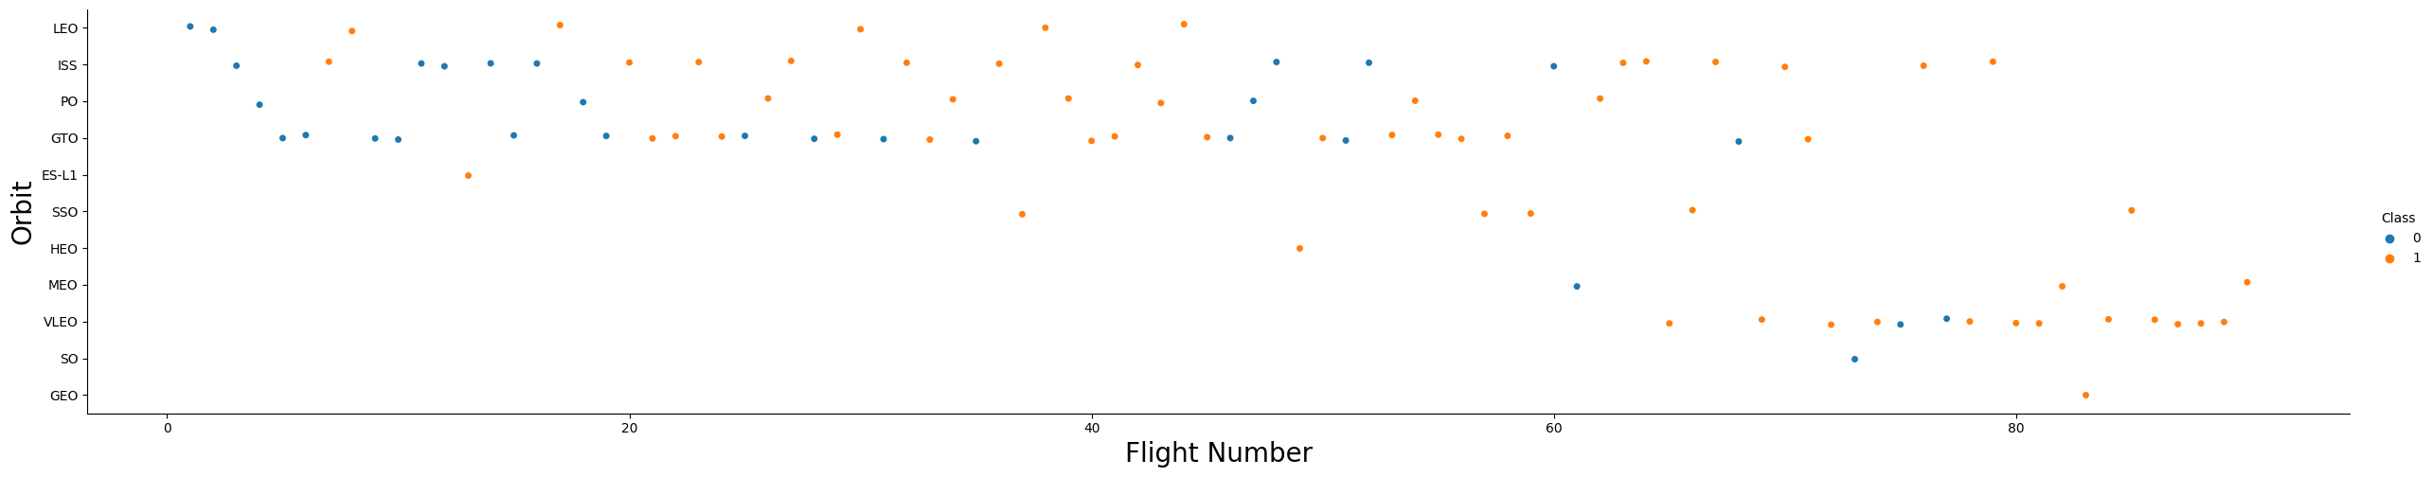
Flight Number vs. Orbit Type
Scatter Plot of Flight number vs. Orbit type

Slide 22
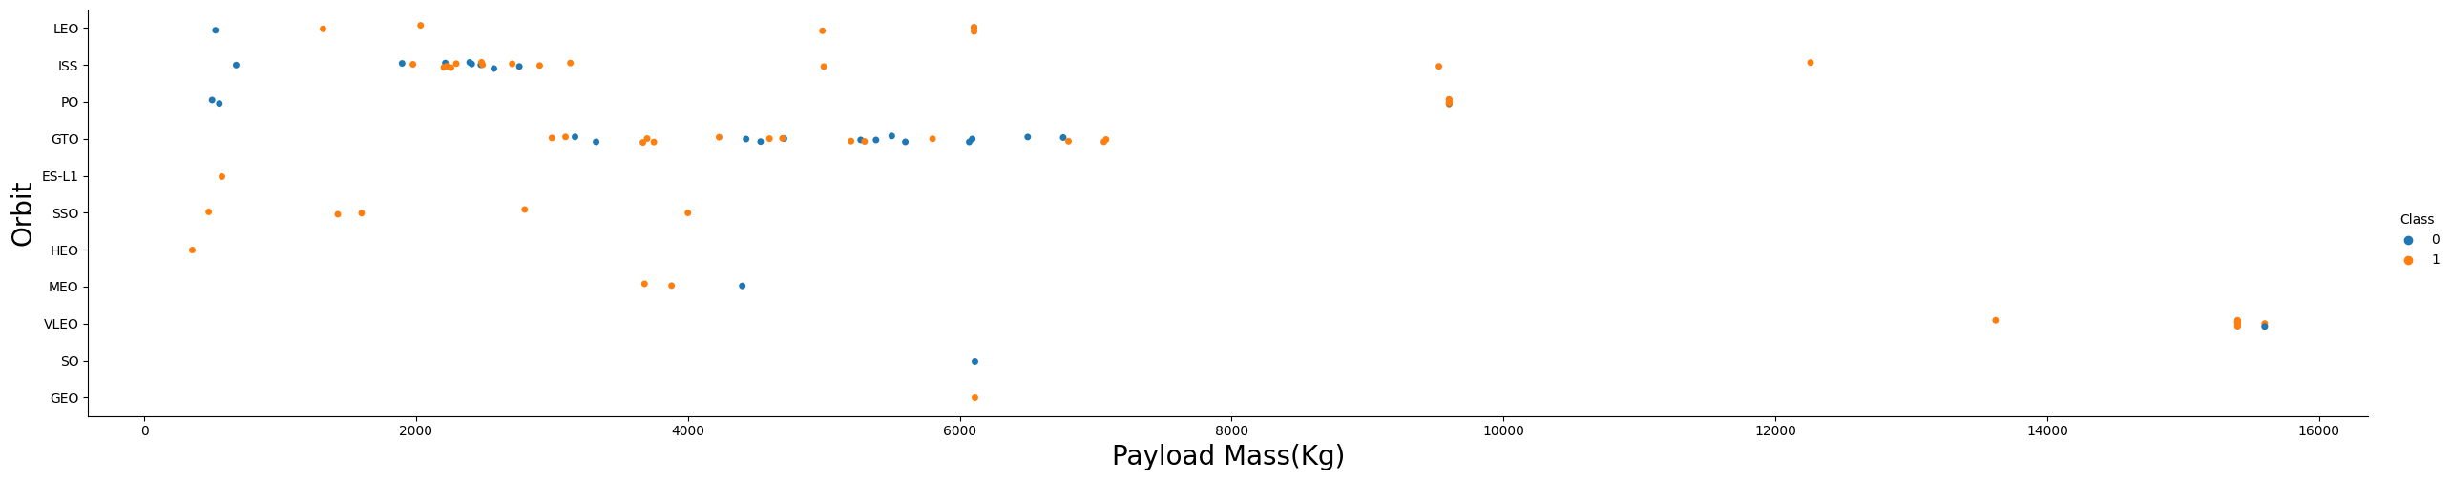
Payload vs. Orbit Type
Scatter plot of payload vs. orbit type

Slide 23
Launch Success Yearly Trend
Show a line chart of yearly average success rate
Show the screenshot of the scatter plot with explanations

Slide 24
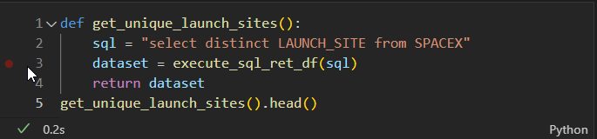
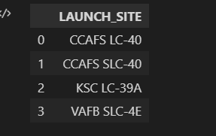
All Launch Site Names
Unique launch sites

Slide 25
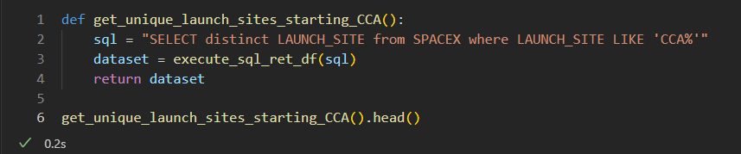
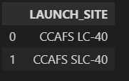
Launch Site Names Begin with 'CCA'
Find 5 records where launch sites begin with `CCA`

Slide 26
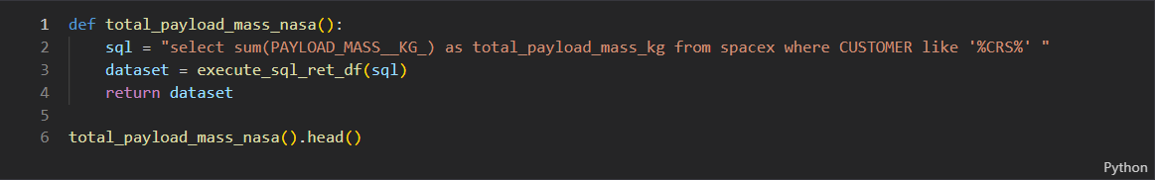
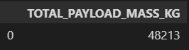
Total Payload Mass
Calculate the total payload carried by boosters from NASA

Slide 27
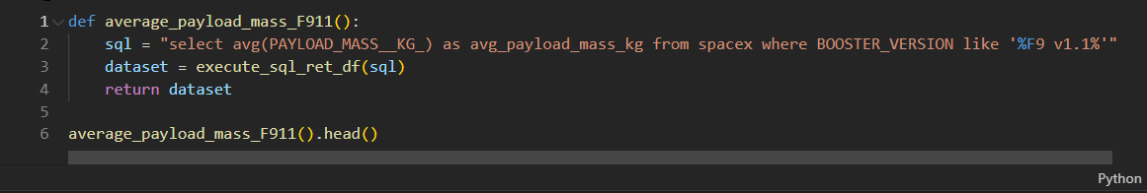
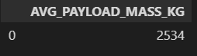
Average Payload Mass by F9 v1.1
Calculate the average payload mass carried by booster version F9 v1.1

Slide 28
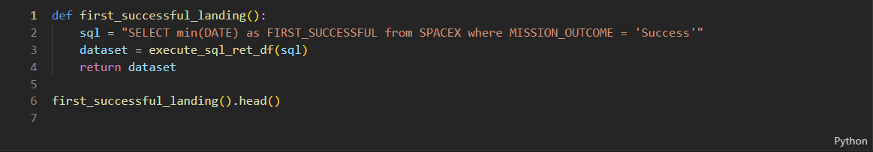
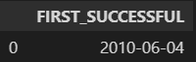
First Successful Ground Landing Date
Find the dates of the first successful landing outcome on ground pad

Slide 29
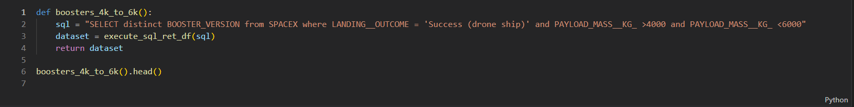
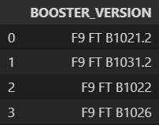
Successful Drone Ship Landing with Payload between 4000 and 6000
List the names of boosters which have successfully landed on drone ship and had payload mass greater than 4000 but less than 6000
Present your query result with a short explanation here

Slide 30
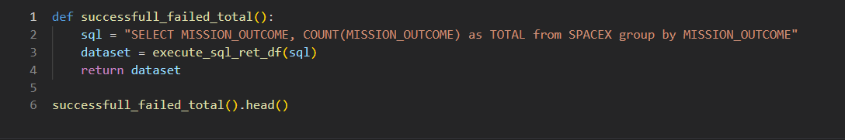
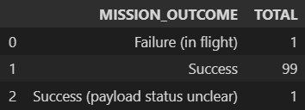
Total Number of Successful and Failure Mission Outcomes
Calculate the total number of successful and failure mission outcomes

Slide 31
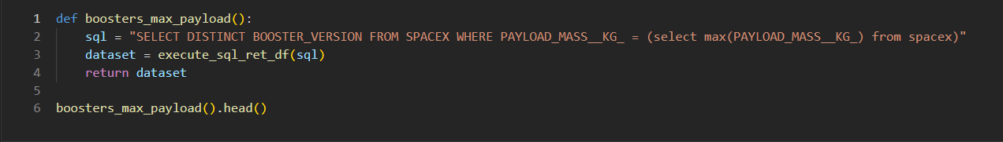
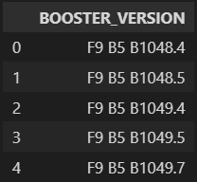
Boosters Carried Maximum Payload
List the names of the booster which have carried the maximum payload mass

Slide 32
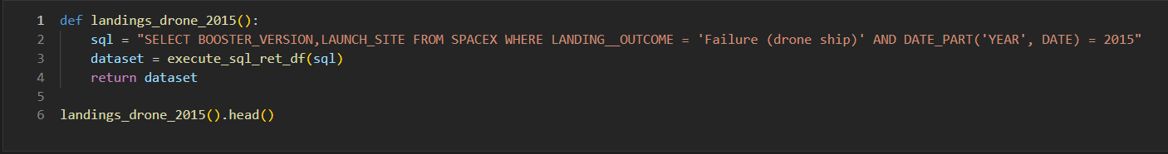
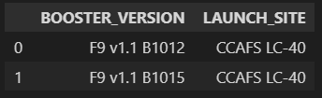
2015 Launch Records
List the failed landing_outcomes in drone ship, their booster versions, and launch site names for in year 2015

Slide 33
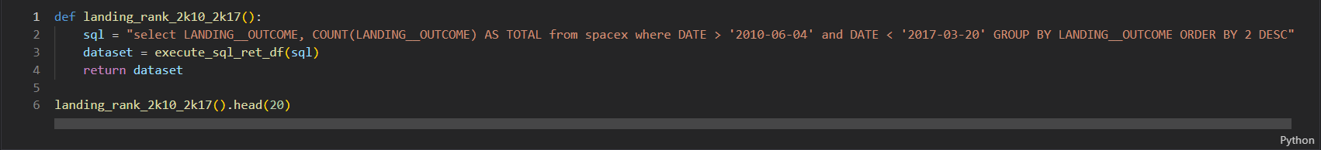
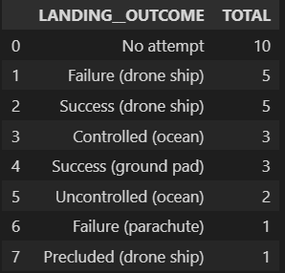
Rank Landing Outcomes Between 2010-06-04 and 2017-03-20
Rank the count of landing outcomes (such as Failure (drone ship) or Success (ground pad)) between the date 2010-06-04 and 2017-03-20, in descending order

Slide 34

Section 3

Slide 35
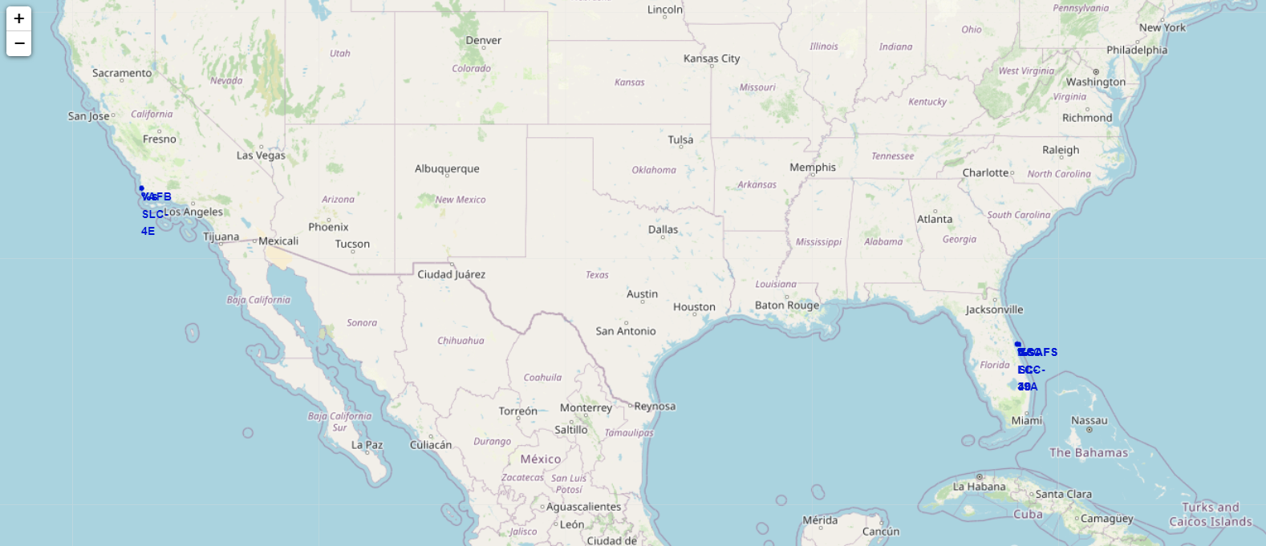
<Folium Map Screenshot 1>

Slide 36
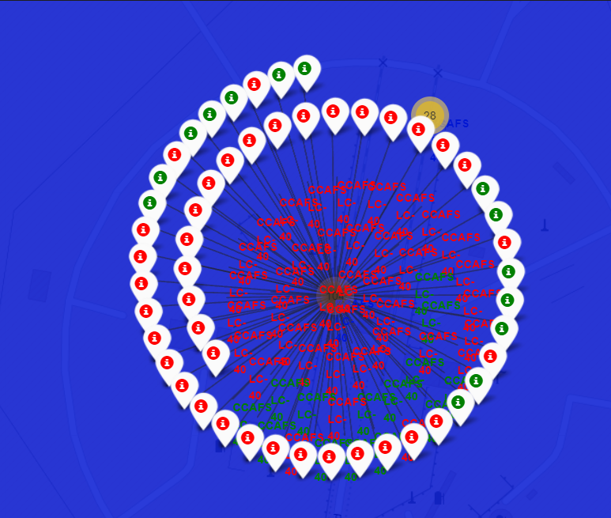
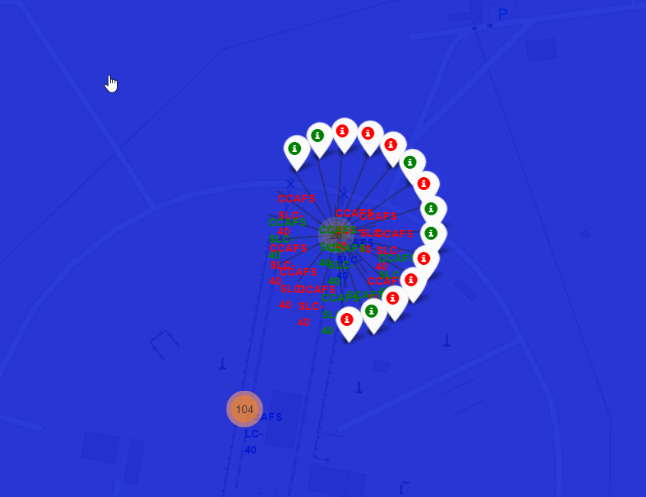
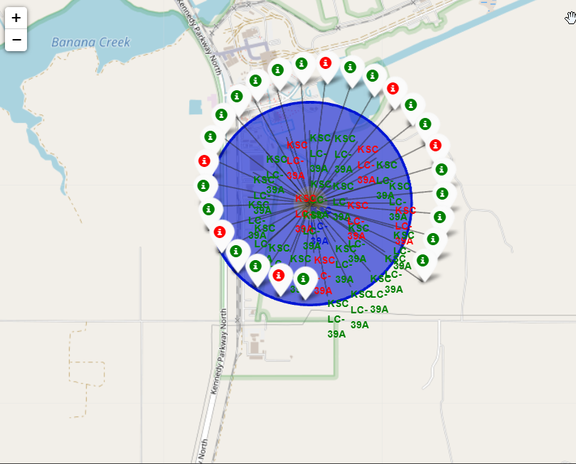
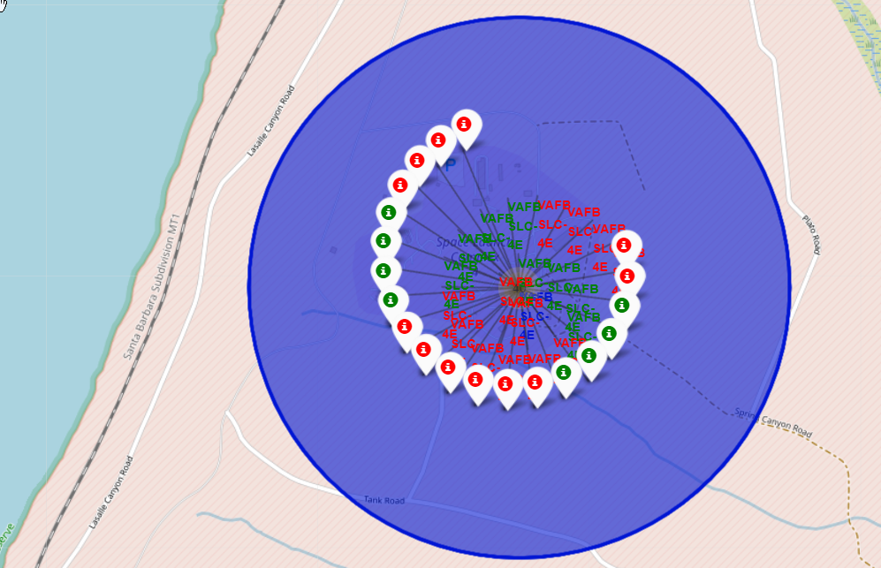
Markers showing launch sites with color labels
Green Marker – Successful launch
Red Marker - Failure

Slide 37
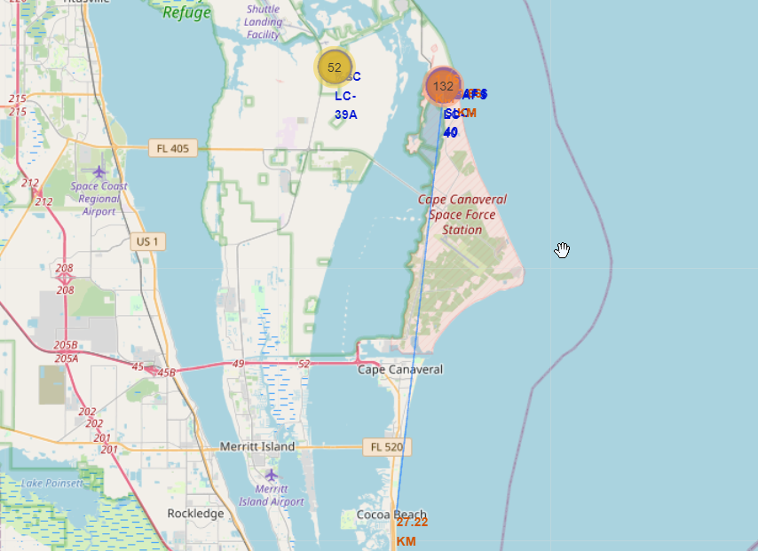
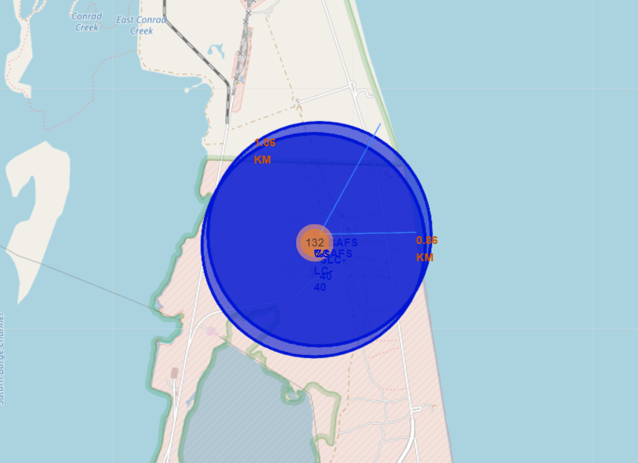
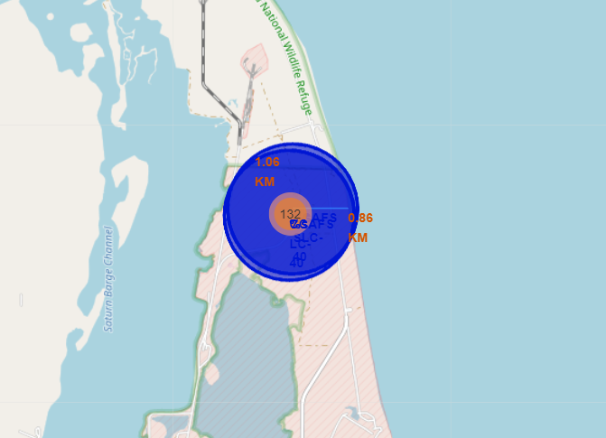
Launch site distance to critical infrastructure

Slide 38
Map exploration analysis
During the visual exploratory analysis, we asked ourselves few questions about the launching infrastructure in relation to the key geographical and industrial features.
Q1: Are launch sites in close proximity to railways?
A1: railways play key component, next to highways, to accommodate cargo needs of a launch site. Launch sites are fairly close to railways allowing shipments go directly to the site.
Q2: Are launch sites in close proximity to highways?
A2: As crucial as railways, yet available to much higher traffic, highways are somehow close to the launch site, but are never too close for
Q3: Are launch sites in close proximity to coastline?
A3: Landing on floating platform and having proximity to closed marine zone allows for safety buffer and to mitigate all unsuccessful starts and landings. All launch sites were built very close to the coastlines.
Q4: Do launch sites keep certain distance away from cities?
A4: As a security risk, all launch sites were properly spaced between closest cities and agglomerations.

Slide 39

Section 4

Slide 40
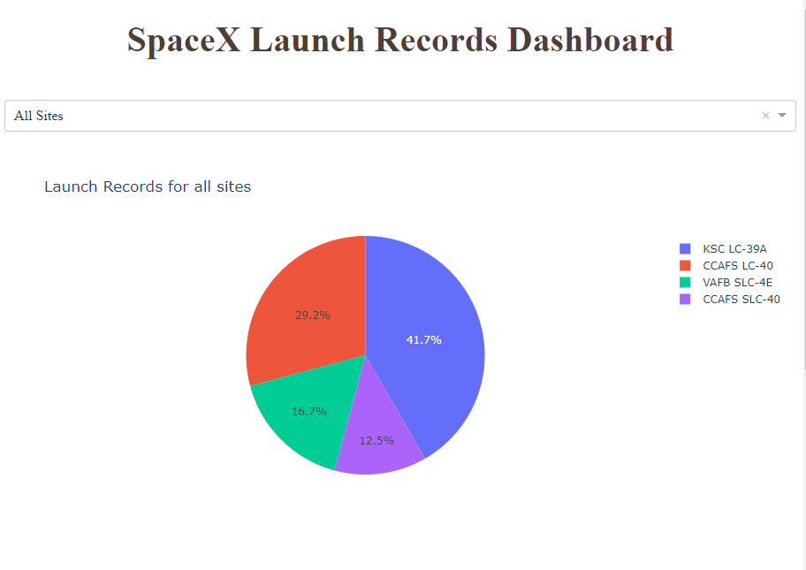
SpaceX Launch Records Dashboard
KSC LC-39A has the greatest amount of launch/landing attempts
CCAFS SLC-40 site has the lowest amount of launch/landing attempts

Slide 41
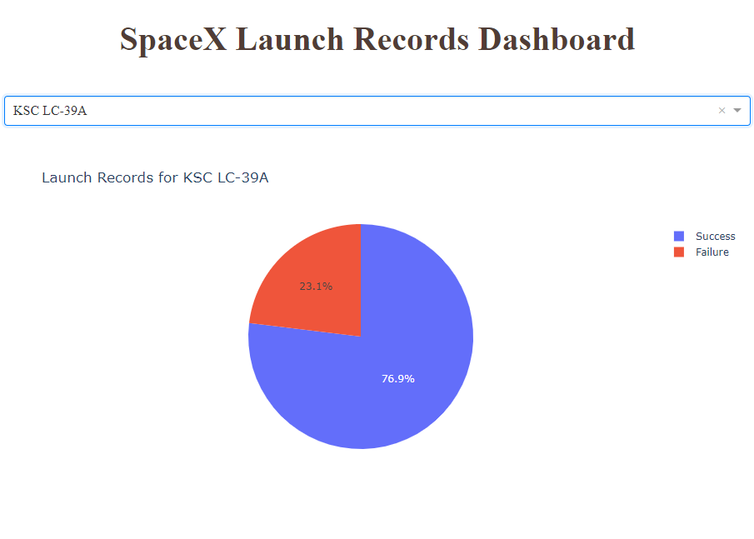
SpaceX Launch Records Dashboard
KSC LC-39A location has the best Success to Failure ratio from all the sites.

Slide 42
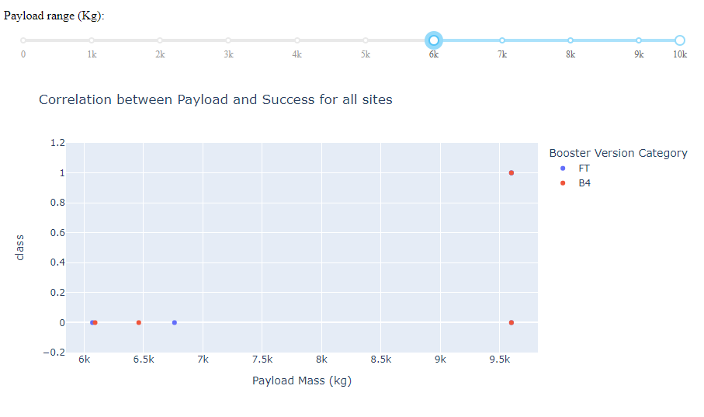
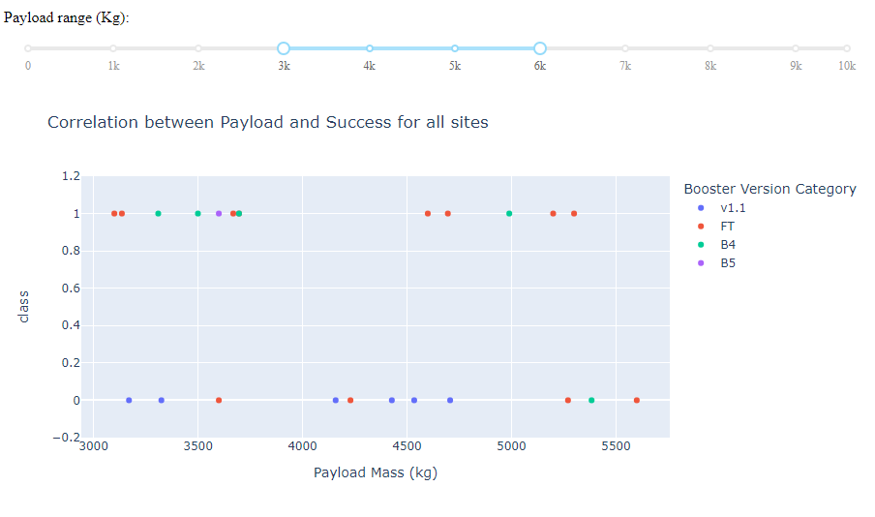
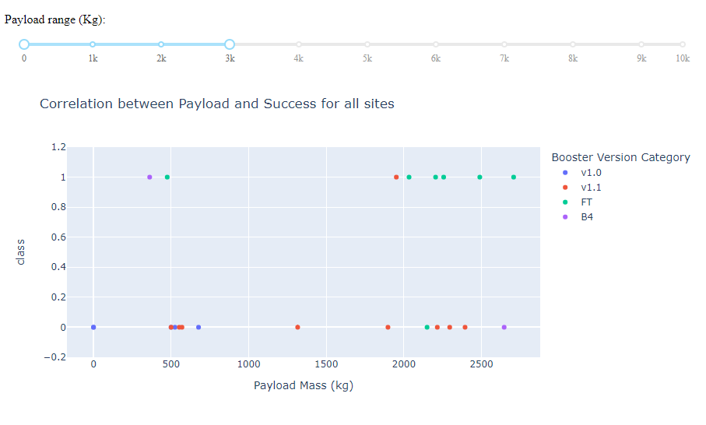
Dashboard
Payload vs Success
Heavy Payload 6k+
Heavier Payloads using B4 and FT boosters are the most successful
FT booster has the greatest fail rate for light payloads
Medium payloads are best served by B4 booster, v1.1 booster results in the greatest fail rate.
Light Payload 0-3k
Medium Payload 3k-6k

Slide 43

Section 5

Slide 44
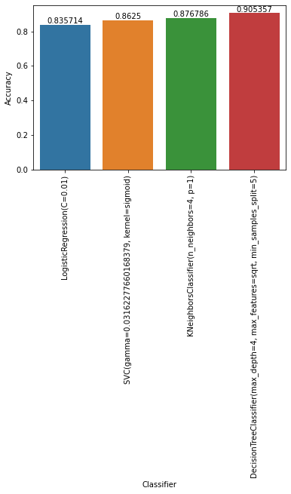
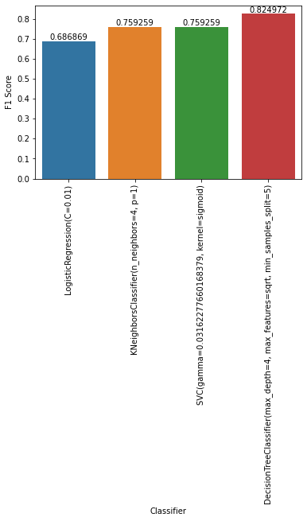
Classification Accuracy
Grid Search Accuracy Score [%]
We used GridSearchCV sklearn library to provide exhaustive search over specified parameter values for all compared estimators. GridSearchCV implements a “fit” and a “score” method. We used fit with train data, and score on test data.
All models were compared using GridSearchCV score, defining model accuracy, and F1 score implemented in sklearn library.
LogisticRegression
C=0.01,
Supported Vector Machine
gamma=0.03162277660168379, kernel=sigmoid
Best models F1 Score [%]
K-Nearest Neighbours
k=4, p=1
Decision Tree (WINNER)
depth=4, max_features=sqrt, min_samples_split=5
Link to IBM Watson Jupiter Notebook with Machine Learning Prediction
Classification Algorightm Selection - IBM Cloud A.I.

Slide 45
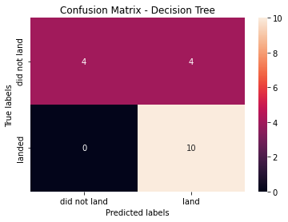
Confusion Matrix
The confusion matrix for the decision tree classifier shows that the classifier can distinguish between the different classes. The major problem is the false positives .i.e., unsuccessful landing marked as successful landing by the classifier.

Slide 46
Conclusions
We can conclude that:
Booster type and payload have huge impact on whether the rocket will land successfully.
The larger the flight amount at a launch site, the greater the success rate at a launch site.
Launch success rate started to increase in 2013 until 2020.
Orbits ES-L1, GEO, HEO, SSO, VLEO had the most success rate.
KSC LC-39A had the most successful launches of any sites.
The Decision tree classifier is the best machine learning algorithm for the task of predicting launch and landing outcome

Slide 47
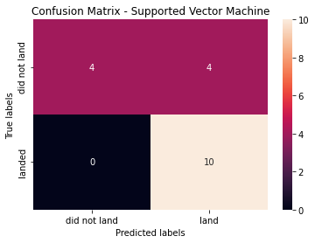

Confusion Matrix for remaining prediction models
Include any relevant assets like Python code snippets, SQL queries, charts, Notebook outputs, or data sets that you may have created during this project

Slide 48
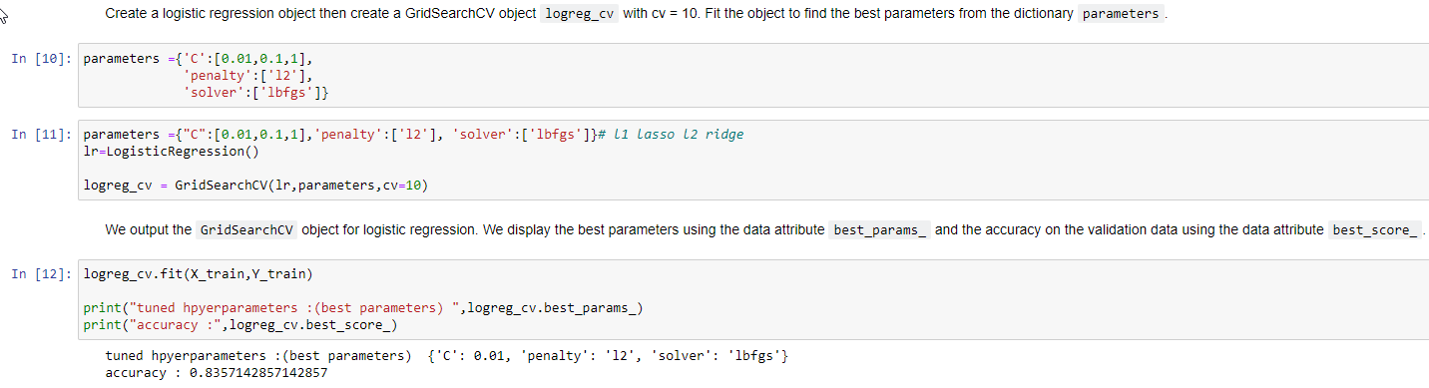
Predictive Model Fine Tunning – Logistic Regression

Slide 49

Predictive Model Fine Tunning – SVM

Slide 50

Predictive Model Fine Tunning – Decision Tree

Slide 51

Predictive Model Fine Tunning – K Nearest Neighbours

Slide 52


